Slide 1

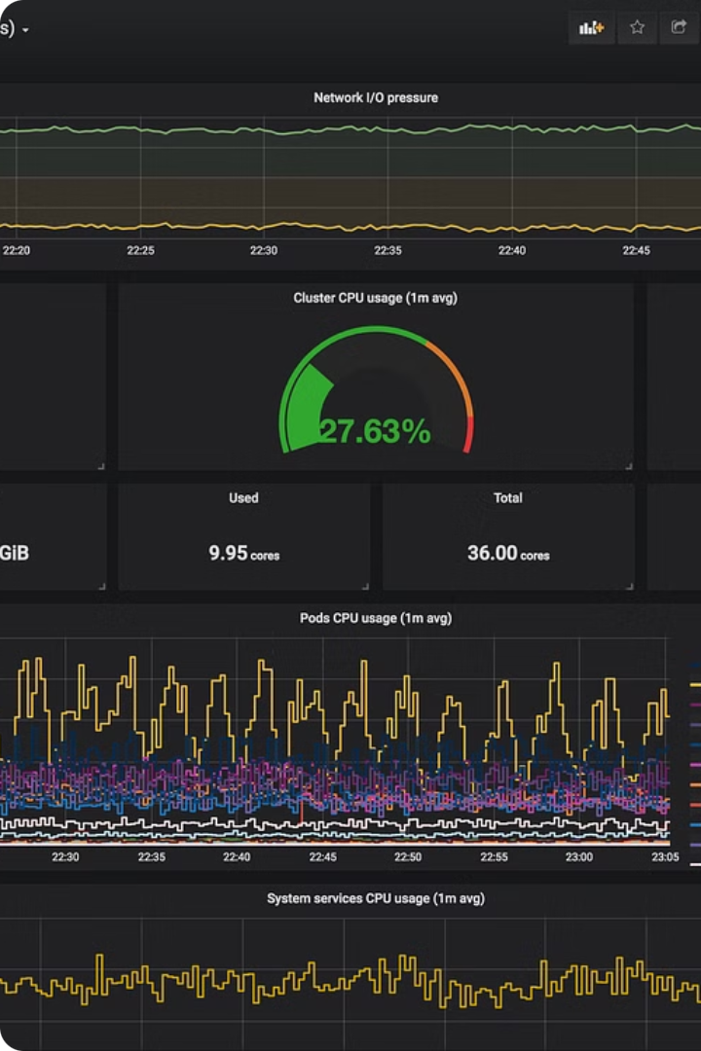

Prometheus: Unlocking the Power of Time Series Monitoring
Prometheus is an open-source monitoring and alerting system designed to track and analyze time-series data. It is a powerful tool that helps organizations monitor their infrastructures, applications, and services, providing valuable insights into system performance, resource utilization, and potential issues.
With its robust features and flexible configuration, Prometheus has become a go-to choice for IT professionals and system administrators seeking a comprehensive monitoring solution.
anishrana2001
https://Devops-wala.com

Slide 2
Agenda
Basic of Prometheus
Install Prometheus
Node Exporter
What is Prometheus?
Time series data
Prometheus VS ?
When to use?
Architecture
Latest packages & Install
Create service
Understanding of Prometheus configuration.
Star, status, & Stop services.
Navigate the URL
What is Node Exporter
Latest packages & Install
Create service
How to add node exporter in Prometheus?
Star, status, & Stop services.
Navigate the URL
Add 2nd Node Exporter
Metrics and Labels
Query & Functions
Jobs and Instances
What is metrics.
Types of Metrics {Counts, Gauge, Histogram, & Summary)
What are labels with example
+ Addition
- subtraction
* Multiplication
/ Division
% Percentage
^ Exponentiation
abs()
clamp_max()
clamp_min()
rate()
What are jobs & Instances
Example

Slide 3
Agenda
Basic of Prometheus
Install Prometheus
Node Exporter
Jobs and Instances
Metrics and Labels
Query & Functions
Push gateway
Defining recording rules
Service Discovery – part 1
What is Push Gateway?
Location of Latest packages & Install.
Create service
Configure Pushgateway to send alarms.
Start, status, & Stop services.
Navigate the URL
File SD
HTTP SD
Difference between File and HTTP
Kubernetes SD
Install and configure with example of nginx server for HTTP SD
What is recording rules.
How to configure it?
Explained with example

Slide 4
Agenda
Basic of Prometheus
Install Prometheus
Node Exporter
Jobs and Instances
Metrics and Labels
Query & Functions
Push gateway
Defining recording rules
Service Discovery – part 1
Alert Manager
Prometheus HA
How to remove tools
What is Alert Manager?
Why we use?
Core features of Alert Manager.
Search, download and configure AlertManager
Integration of Alert Manager with Prometheus.
Lab for core feature.
Alert Manager HA setup
Lab
Why Prometheus HA
Multiple Prometheus servers
Lab for Multiple Prometheus servers
Prometheus Federation
Type of Federation Lab
Hierarchical federation
Cross-service federation
Uninstallation of
Prometheus HA
AlertManager HA
Alertmanager
Service Discovery
Push Gateway
Node Exporter
Prometheus

Slide 5
Agenda
Basic of Prometheus
Install Prometheus
Node Exporter
Jobs and Instances
Metrics and Labels
Query & Functions
Push gateway
Defining recording rules
Service Discovery
Alert Manager
Prometheus HA
How to remove tools
Service Discover - Part 2
Prometheus Installation through Helm in Kubernetes
Explore the Prometheus components one by one
How to check the configuration
How to modify the config file
How to restart the services
Installation of MongoDB-exporter
How to intergrade exporter with Prometheus.
How to remove MongoDB exporter
How to uninstall Prometheus from helm.

Slide 6
01 NOW WE WILL TALK ABOUT
Basic of Prometheus
Notes:
In this lesson, we will be going to talk about What is Prometheus.

Slide 7
Basic of Prometheus
What is Prometheus?
Time series data
Prometheus VS ?
When to use Prometheus?
Prometheus Architecture

Slide 8
Prometheus stands as a prominent open-source solution within the realm of monitoring and alerting systems.
It is Written in Go language and licensed under Apache2.
It's a metric-based monitoring system developed by SoundCloud in 2012
Prometheus offers a multi-dimensional data model, operational simplicity, scalable data collection, Time series DB and a powerful query language, all in a single tool.
In 2016, the Prometheus project become a part of Cloud Native
Computing Foundation (CNCB).
Prometheus has continued to evolve, with its latest stable
release being version 2.53.0 as of June 2024
It is widely used in the industry for monitoring and alerting,
and it has a very active developer and user community.

Slide 9

Time Series Metrics
You have a web application that serves thousands of users daily. To ensure it runs smoothly, you set up metric-based monitoring called Prometheus.
Client Server
Time
CPU Usage
Memory Usage (GB)
10.5%
10:00:00
10.5%
6.00
10:00:15
20%
8.00
10:00:00 CPU?
10:00:30
8%
5.7
10:00:45
7%
5.8
10:01:00
9%
4.6
10:01:15
14%
9
10:01:30
14.8%
8.7
10:01:45
13%
8
10:02:00
10%
8.5
10:00:13
??
??

Slide 10
Prometheus
Loki
Syslog
Type: Metrics Monitoring Tool
Type: Log Aggregation Tool
Type: Logging Protocol
Where To Use
Monitor the CPU, RAM, Hard disk, error messages
Where To Use
Monitor the logs of file i.e. Web server, Database, etc
Trace the logs.
Where To Use
Forward the system logs with the help of syslog protocol
Use Case
Monitoring system performance, application metrics, and infrastructure health.
Use Case
Centralized logging, troubleshooting, and log analysis.
Use Case
Collecting logs from network devices, servers, and applications for monitoring and troubleshooting
Key Features
Uses a powerful query language called PromQ
Key Features
Supports LogQL for querying logs
Key Features
Uses a simple, text-based format for log messages.

Slide 11

Service discover
Pagerduty
Short-lived jobs
Kubernetes
file_sd
http_sd_configs
Email
Alert Manager
Push Gateway
Discovery target
Prometheus Server
Push alerts
Pull metrics
Retrieval
HTTP Server
TSDB
Prometheus Web UI
PromQl
Grafana
Node Hard disk
Client Machines
API Clients
Node Exporter

Slide 12
Service discover
Short-lived jobs
Kubernetes
file_sd
http_sd_configs
Push Gateway
Discovery target
Prometheus Server
Pull metrics
Retrieval
TSDB
HTTP Server
Master1.example.com
Master1
Prometheus
NodeExporter
workernode1
NodeExporter
Alert Manager1
Prometheus2
workernode2
Pushgateway
Alert Manager2
Prometheus-Federation
Nginx
Service Discovery
servers
Node Exporter

Slide 13
02 NOW WE WILL TALK ABOUT
Install Prometheus

Slide 14
Agenda
Prerequisites of Installation of Prometheus server
Latest packages & Install
Create service
Understanding of Prometheus configuration.
Star, status, & Stop services.
Navigate the URL
What are the system requirements for installing Prometheus on a VM?
How do you download the Prometheus binaries for installation?
What configuration files need to be set up for Prometheus after installation?
How can you start and verify the Prometheus service on a VM?

Slide 15
To install Prometheus on a virtual machine, you’ll need to ensure your system meets the following requirements:
Operating System: Linux (e.g., Ubuntu 20.04 LTS) or Windows.
CPU: At least 2 CPU cores.
Memory: Minimum 4GB of RAM.
Disk Space: At least 20GB of free disk space.
Network: Open ports 9090 (for Prometheus server) and 9100 (for Node Exporter) if you plan to use it.

Slide 16



Installing Prometheus: A Step-by-Step Guide
Download
Extract
Configure
Visit the official Prometheus website to download the latest version of the software. The binaries are available for various operating systems, including Linux, Windows, and macOS.
https://prometheus.io/download/
Extract the downloaded package to a directory of your choice. This will provide you with the necessary files and directories to run Prometheus.
Customize the Prometheus configuration file (prometheus.yml) to specify the data sources you want to monitor, the scrape intervals, and any additional settings according to your requirements.

Slide 17
Managing Prometheus Services
Starting Prometheus
Checking Prometheus Status
Stopping Prometheus
To start the Prometheus service, navigate to the extracted directory and run the following command:
You can check the status of the Prometheus service by accessing the web UI at http://localhost:9090. This will provide you with an overview of the running Prometheus instance, including metrics, alerts, and configuration details.
To stop the Prometheus service, simply press Ctrl+C in the terminal where the service is running. Alternatively, you can create a systemd service to manage the Prometheus process and use the standard systemctl commands to start, stop, and check the status of the service.
./prometheus --config.file=prometheus.yml
This will launch the Prometheus server and start collecting data from the configured data sources.

Slide 18
global:
scrape_interval: 15s
evaluation_interval: 15s
rule_files:
# - "first.rules"
# - "second.rules"
scrape_configs:
- job_name: prometheus
scrape_interval: 30s
scrape_timeout: 5s
static_configs:
- targets: ['localhost:9090']
Global Configuration
The global configuration specifies parameters that are valid in all other configuration contexts. They also serve as defaults for other configuration sections.
scrape_interval: How frequently to scrape targets by default. The default is 1 minute.
scrape_timeout: How long until a scrape request times out. The default is 10 seconds.
evaluation_interval: How frequently to evaluate rules. The default is 1 minute.

Slide 19
02 It’s time for LAB
Prometheus Installation LAB

Slide 20
What are the system requirements for installing Prometheus on a VM?
2 CPU, 4 GB RAM and 20 GB Hard disk.
How do you download the Prometheus binaries for installation?
wget https://github.com/prometheus/prometheus/releases/download/v2.52.0/prometheus-2.52.0.linux-amd64.tar.gz
tar xvf prometheus-2.52.0.linux-amd64.tar.gz
What configuration files need to be set up for Prometheus after installation?
prometheus.yml
How can you start and verify the Prometheus service on a VM?
systemctl start Prometheus
http://192.168.1.31:9090/metrics

Slide 21
03 NOW WE WILL TALK ABOUT
Node Exporter

Slide 22
Understanding Node Exporter:
What is the Node Exporter?
How does it collect Linux system-related metrics?
What hardware and operating system-level metrics does it expose?
Deployment and Configuration:
What port does it expose metrics on?
Prometheus Integration:
How does Prometheus scrape metrics from the Node Exporter?
What configuration is needed in your Prometheus instance to access Node Exporter metrics?

Slide 23
The Prometheus Node Exporter is a crucial component in the Prometheus ecosystem.
Purpose:
The Node Exporter serves as an exporter specifically designed to collect and expose hardware- and kernel-related metrics from Linux-based systems (such as servers, VMs, or containers).
It provides a way to monitor various aspects of the host system, including CPU usage, memory, disk I/O, network traffic, and more.
How It Works:
The Node Exporter runs as a standalone binary on the target system.
It listens on port 9100 by default, exposing an HTTP endpoint where metrics are available.
Prometheus scrapes these metrics from the Node Exporter to collect data for monitoring and alerting.
Metrics Exposed:

Slide 24
Prometheus Server
Pull metrics
Retrieval
HTTP Server
TSDB
Node Hard disk
9100
Client Machines
Node Exporter

Slide 25
The Prometheus Node Exporter is a crucial component in the Prometheus ecosystem.
Purpose:
The Node Exporter serves as an exporter specifically designed to collect and expose hardware- and kernel-related metrics from Linux-based systems (such as servers, VMs, or containers).
It provides a way to monitor various aspects of the host system, including CPU usage, memory, disk I/O, network traffic, and more.
How It Works:
The Node Exporter runs as a standalone binary on the target system.
It listens on port 9100 by default, exposing an HTTP endpoint where metrics are available.
Prometheus scrapes these metrics from the Node Exporter to collect data for monitoring and alerting.
Metrics Exposed:
The Node Exporter exposes a wide variety of metrics, including:
CPU-related metrics (usage, load, temperature)
Memory usage and swap metrics
Disk I/O and filesystem statistics
Network traffic and errors
System uptime, boot time, and more

Slide 26




Introducing Node Exporter: Monitoring Your Hosts
CPU Utilization
Memory Usage
Disk Metrics
Network Performance
Monitor the CPU usage of your hosts, including individual cores and overall system utilization.
Track the memory usage of your hosts, including available, used, and free memory.
Gather detailed information about your host's disk storage, including read/write operations, disk space, and I/O latency.
Monitor the network traffic and performance of your hosts, including bandwidth utilization, packet loss, and connection statistics.

Slide 27
Integrating Node Exporter with Prometheus
Locate & Install Node Exporter
Create new (user and service)
Configure Prometheus
Update the Prometheus configuration file (prometheus.yml) to include the targets (hostnames or IP addresses) of the Node Exporter instances you want to monitor. In the end, restart the Prometheus ser
Locate the latest packet, download and install the Node Exporter on each host you want to monitor. This can be done using the official binary or through package managers like apt or yum.
Create a new user (node_exporter) and then bind with exporter service.

Slide 28
Service discover
Short-lived jobs
Kubernetes
file_sd
http_sd_configs
Push Gateway
Discovery target
Prometheus Server
Pull metrics
Retrieval
TSDB
HTTP Server
Master1.example.com
Master1
Prometheus
NodeExporter
workernode1
NodeExporter
Alert Manager1
Prometheus2
workernode2
Pushgateway
Alert Manager2
Prometheus-Federation
Nginx
Service Discovery
servers
Node Exporter

Slide 29
03 It’s time for LAB
Node Exporter LAB

Slide 30
The Node Exporter in Prometheus exposes a wide variety of hardware and operating system-level metrics. Here are some key metrics it collects:
CPU Metrics:
CPU usage
CPU load
CPU temperature
Disk Metrics:
Disk I/O
Disk usage
Filesystem statistics
Memory Metrics:
Memory usage
Swap usage
Network Metrics:
Network traffic
Network errors
Network interface statistics
System Metrics:
System uptime
Boot time
Context switches
Interrupts

Slide 31
04 NOW WE WILL TALK ABOUT
Jobs and Instances

Slide 32
In Prometheus terms, an endpoint you can scrape is called an instance, usually corresponding to a single process.
A collection of instances with the same purpose, a process replicated for scalability or reliability for example,
is called a job.
job: The configured job name that the target belongs to.
instance: The <host>:<port> part of the target's URL that was scraped.
- job_name: “node-exporter" # Added
static_configs: # Added
- targets: ['192.168.1.7:9100', '192.168.1.32:9100'] # Added

Slide 33
05 NOW WE WILL TALK ABOUT
Metrics and Labels

Slide 34
Understanding Prometheus Metrics and Labels
1
Metrics
Every metric in Prometheus has a name, that name is call Metric name. Metrics name specific to an application, the prefix is usually the application name itself.
Sometimes, however, metrics are more generic, like standardized metrics exported by client libraries. Examples: prometheus_notifications_total (specific to the Prometheus server)
Prometheus collects various metrics, such as CPU usage, memory utilization, network traffic, and application-specific metrics. These metrics can be used to gain insights into the performance and health of your systems and applications.
2
Metric Types
Prometheus supports different metric types, including
Counters (cumulative values),
Gauges (instantaneous values),
Histograms (value distributions), and
Summaries (quantile-based value distributions).

Slide 35

Counter Metrics
Description
Counters are a type of metric that represent a cumulative value that can only increase over time or reset the value to 0. counters only count upward.
They are commonly used to track the number of events, such as HTTP requests, errors, or database queries.
Use Cases
Counters are useful for monitoring the growth of a value over time, such as the total number of requests processed by an application, or the number of errors encountered in a system.
Example
The number of successful HTTP requests handled by a web server is a common example of a counter.
Executing the command “ifconfig”, you will observe the error messages increasing over the time.

Slide 36
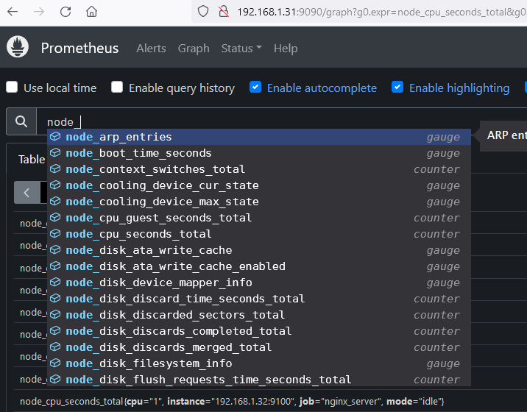
Notes:
Go to URL: http://192.168.1.31:9090
In the End: Now the question, here is in production, we have application where values are up or down.

Slide 37

Gauge Metrics
Description
Gauges are a type of metric that represent a value that can increase or decrease over time. They are used to measure the current state of a system, such as the amount of memory used, the number of active connections, or the temperature of a server. Gauges will count upward and downward.
Use Cases
Gauges are useful for monitoring the current state of a system, such as the available capacity of a resource or the current load on a server.
Example
The current CPU utilization of a server is a common example of a gauge metric.

Slide 38
Histogram Metrics
Description
Histograms are a type of metric that measure the distribution of a value over time. They are used to track the frequency and duration of events, such as the response times of an API or the duration of database queries.
A histogram counts the number of observations/events that fall into a set of configuration buckets (rules), each buckets separate by time series. A histogram uses a labels to differentiate between buckets.
Use Cases
Histograms are useful for understanding the performance characteristics of a system, such as the latency of requests or the duration of database queries.
Example
The response time of an HTTP request is a common example.
http_request_duration_seconds_buckets{le="0.2"}
http_request_duration_seconds_buckets{le="0.5"}
http_request_duration_seconds_buckets{le="1.0"}
http_request_duration_seconds_buckets{ge="5.0"}

Slide 39
Summary Metrics
Description
Summary metrics are a type of metric that provide statistical information about a set of values, such as the sum, count, minimum, maximum, and quantiles.
It is like histogram metric, but it expose metrices in the form of quantiles instead of buckets.
Use Cases
Summary metrics are useful for understanding the distribution of a value, such as the latency of requests or the size of responses.
Example
The latency of HTTP requests, with calculated quantiles, is a common example of a
summary metric.

Slide 40
How Labels Work
Example
node_cpu_seconds_total
{cpu=“0”}
node_cpu_seconds_total
{cpu=“1”}

Slide 41
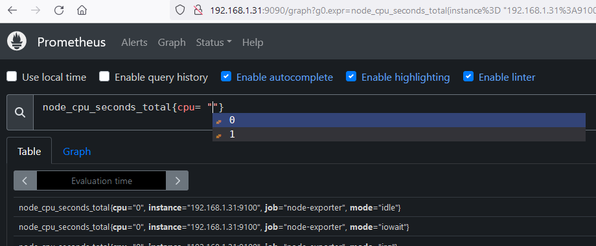
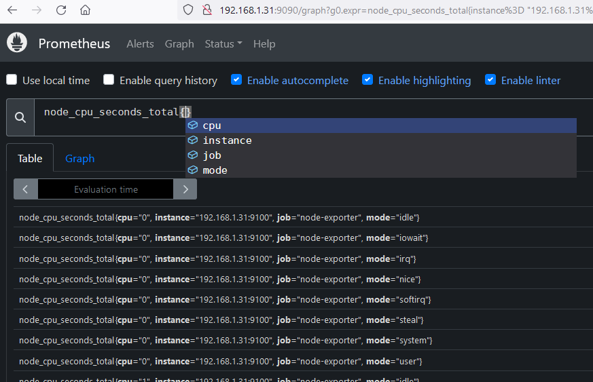

Slide 42
How Labels Work
Unique Identification
Filtering and Querying
Labels allow Prometheus to uniquely identify each time-series data point, enabling efficient storage and retrieval.
Users can filter and query metrics using label selectors, making it easy to isolate and analyze specific data.

Slide 43
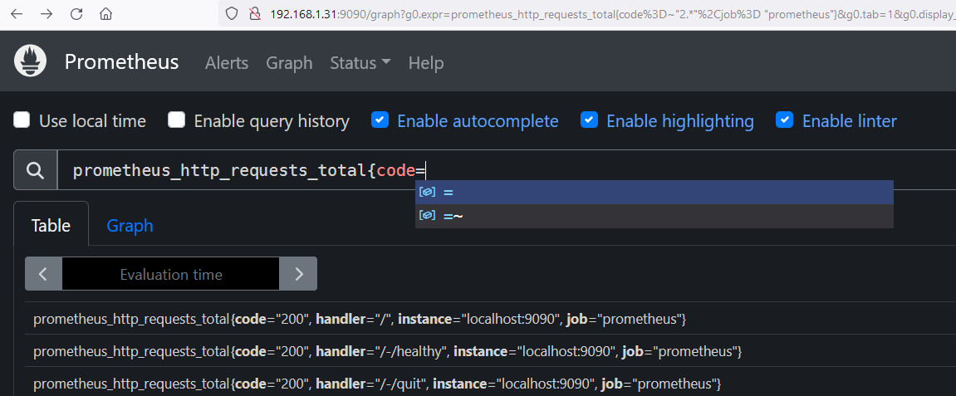
Filter data with labels in PromQL
We’ve seen that Prometheus data have labels, allowing us to filter the metrics we have stored. Here’s an overview of the label matching operators:
= : Select labels that are exactly equal to the provided string.
!= : Select labels that are not equal to the provided string.
=~ : Select labels that regex-match the provided string.
!~ : Select labels that do not regex-match the provided string.

Slide 44
How Labels Work
Unique Identification
Filtering and Querying
Labels allow Prometheus to uniquely identify each time-series data point, enabling efficient storage and retrieval.
Users can filter and query metrics using label selectors, making it easy to isolate and analyze specific data.
Aggregation
Alerting
Labels enable powerful aggregation functions in Prometheus, allowing users to calculate summaries, averages, and other statistical insights.
Labels are essential for defining alerting rules in Prometheus, helping to identify and respond to critical issues.

Slide 45
Example Prometheus Labels
Service
Environment
Instance
Labels like "service=web" or "service=database“.
It help organize metrics by the specific service they belong to.
Labels like "environment=production" or "environment=staging“.
It allow for easy monitoring of different environments.
Labels like "instance=web-01" or "instance=database-02“.
It uniquely identify individual instances of a service.

Slide 46
05 NOW WE WILL TALK ABOUT
Lab for Metrics and Labels

Slide 47
06 NOW WE WILL TALK ABOUT
Query & Functions

Slide 48
Querying Prometheus
Prometheus offers a functional query language called PromQL (Prometheus Query Language) that helps the user to select and aggregate time series data in real time.
The result of an expression can either be shown as a graph, viewed as tabular data in Prometheus's expression browser, or consumed by external systems via the HTTP API.
Example
https://prometheus.io/docs/prometheus/latest/querying/basics/
prometheus_http_requests_total
prometheus_http_requests_total{handler="/api/v1/query"}
prometheus_http_requests_total{handler="/api/v1/query"}[5m]
In Prometheus, an expression or sub-expression can evaluate to one of four types:
Instant vector - a set of time series containing a single sample for each time series, all sharing the same timestamp
Range vector - a set of time series containing a range of data points over time for each time series
Time Durations
Offset modifier
@ modifier
Scalar - a simple numeric floating-point value
String - a simple string value; currently unused

Slide 49
Time Durations
ms - milliseconds
s - seconds
m - minutes
h - hours
d - days - assuming a day always has 24h
w - weeks - assuming a week always has 7d
y - years - assuming a year always has 365d
(node_memory_Active_bytes{job="node-exporter"}[5m])
(node_memory_Active_bytes{job="node-exporter"}[1h])
(node_memory_Active_bytes{job="node-exporter"}[1d])
Offset modifier
The offset modifier allows changing the time offset for individual instant and range vectors in a query.
(node_memory_Active_bytes{job="node-exporter"} offset 1h)
@ modifier
The @ modifier allows changing the evaluation time for individual instant and
range vectors in a query.
(node_memory_Active_bytes{job="node-exporter"} @1726320581.017)

Slide 50
1. Instant Vector
An Instant Vector is a set of time series containing a single sample for each time series, all sharing the same timestamp.
Example:
prometheus_http_requests_total
This query returns the latest value of the node_memory_Active_bytes metric for all time series.
2. Range Vector
A Range Vector is a set of time series containing a range of data points over time for each time series.
Example:
prometheus_http_requests_total{handler="/api/v1/query"}[5m]
This query returns all the samples of the node_memory_Active_bytes metric within the last 5 minutes for each time series.
3. Scalar
A Scalar is a simple numeric floating-point value.
Example:
rate(prometheus_http_requests_total{handler="/api/v1/query"}[5m])
This query calculates the per-second rate of node_memory_Active_bytes over the last 5 minutes, returning a
single numeric value.
4. String
A String is a simple string value. Currently, this type is not used in Prometheus.
Example: While Prometheus does not currently use string values in expressions,
you might encounter string literals in other contexts, such as labels or annotations.

Slide 51
Querying Prometheus: A Powerful Tool
Operator
Description
+
Addition
-
Subtraction
*
Multiplication
/
Division
%
Percentage
^
Exponentiation
Prometheus provides a powerful query language that allows you to explore and analyze your time-series data. You can use various functions, such as abs(), clamp_max(), clamp_min(), and rate(), to manipulate and transform your metrics.

Slide 52
abs()
Returns the absolute value of each element in the vector.
If the data points of a time series fluctuate between positive and negative values, you can apply the abs() function to display each data point as an absolute value (the distance from zero).
clamp_max()
It return value but replace them with a maximum value if they exceed that value.
clamp_max(node_cpu_seconds_total,100)
clamp_min()
It return value but replace them with a minimum value if they exceed that value.
clamp_min(node_cpu_seconds_total,10)
rate()
It provide average per-second rate of increase in a time series value.
clamp_max(node_cpu_seconds_total{mode="idle"}, 100)
clamp_min(node_cpu_seconds_total{mode="idle"}, 1000)
rate(node_cpu_seconds_total{instance="192.168.1.31:9100",mode="user"}[2m])

Slide 53
06 NOW WE WILL TALK ABOUT
Lab Query & Functions

Slide 54
07 NOW WE WILL TALK ABOUT
Push gateway

Slide 55
Pagerduty
Short-lived jobs
Email
Alert Manager
Third party tool
Push Gateway
Prometheus Server
Push alerts
Pull metrics
Retrieval
HTTP Server
TSDB
Prometheus Web UI
PromQl
Grafana
Node Hard disk
Client Machines
API Clients
Node Exporter

Slide 56
Service discover
Short-lived jobs
Kubernetes
file_sd
http_sd_configs
Push Gateway
Discovery target
Prometheus Server
Pull metrics
Retrieval
TSDB
HTTP Server
Master1.example.com
Master1
Prometheus
NodeExporter
workernode1
NodeExporter
Alert Manager1
Prometheus2
workernode2
Pushgateway
Alert Manager2
Prometheus-Federation
Nginx
Service Discovery
servers
Node Exporter

Slide 57
When to use the Pushgateway
Pushgateway service helps us to provides a push-based method for sending metrics to Prometheus for special cases that need such a method.
Thus, we can say that the Pushgateway is an intermediary service which allows you to push metrics from jobs which cannot be scraped.
There are several pitfalls when blindly using the Pushgateway instead of Prometheus's usual pull model for general metrics collection:
- When monitoring multiple instances through a single Pushgateway, the Pushgateway becomes both a single point of failure and a potential bottleneck.
- You lose Prometheus's automatic instance health monitoring via the up metric (generated on every scrape).
- The Pushgateway never forgets series pushed to it and will expose them to Prometheus forever unless those series are manually deleted via the Pushgateway's API.

Slide 58
Alternative strategies:
If an inbound firewall or NAT is preventing you from pulling metrics from targets, consider moving the Prometheus server behind the network barrier as well. It is generally recommend running Prometheus servers on the same network as the monitored instances.
Otherwise, consider PushProx, which allows Prometheus to traverse a firewall or NAT.
https://prometheus.io/docs/instrumenting/exporters/
Prometheus exporters allow you to collect metrics from a wide variety of systems and applications so they can be scraped by a Prometheus server.
There are a number of libraries and servers which help in exporting existing metrics from third-party systems as Prometheus metrics.
This is useful for cases where it is not feasible to instrument a given system with Prometheus metrics directly (for example, HAProxy or Linux system stats).

Slide 59
Installing Pushgateway : A Step-by-Step Guide
Download
Extract
Configure
Visit the official Prometheus website to download the latest version of the software. The binaries are available for various operating systems, including Linux, Windows, and macOS.
https://prometheus.io/download/
Extract the downloaded package to a directory of your choice. This will provide you with the necessary files and directories to run Pushgateway.
Create a user and Customize the Pushgateway . After that create service then run the Pushgateway

Slide 60
07 NOW WE WILL TALK ABOUT
Lab for Push gateway

Slide 61
08 NOW WE WILL TALK ABOUT
Defining rules
https://www.linkedin.com/in/anishrana2001/

Slide 62
Rules
recording rules
alerting rules
Rule files use YAML.

Slide 63
What Are Recording Rules?
Definition: Recording rules allow you to define expressions in PromQL (Prometheus Query Language) that are evaluated regularly and stored as new time series.
Purpose: They are designed to optimize performance by precomputing expensive or frequently used queries, making it faster to retrieve these results later.
rate(prometheus_http_requests_total{handler="/api/v1/query"}[5m])
Why Use Recording Rules?
Performance Improvement: Recording rules precompute frequently needed or computationally expensive expressions and save their results as new time series. This makes querying these precomputed results much faster than executing the original expression every time.
Simplification: They help simplify complex or repetitive PromQL subexpressions,
making your queries easier to manage and understand.
Efficiency: By reducing the computational load on the Prometheus server,
recording rules help maintain efficient and scalable monitoring setups.

Slide 64
When to Use Recording Rules?
Frequent Queries: When you have queries that are run frequently, such as those used in dashboards that refresh often.
Complex Calculations: When dealing with complex calculations that are computationally expensive and slow to execute.
Aggregations: When you need to perform aggregations or transformations on raw time series data.
Where to Use Recording Rules?
Dashboards: Ideal for dashboards that need to load quickly and display precomputed metrics.
Alerts: While primarily used for performance, recording rules can also be used in conjunction with alerting rules to precompute conditions that trigger alerts.
Large-Scale Environments: In production environments where query performance and server efficiency are critical.

Slide 65
[root@master1 rules]# cd /etc/prometheus/rules
[root@master1 rules]# vi cluster1_rule.yaml
groups: - name: nginx_server interval: 15s rules: - record: recording_rule_node_cpu_seconds_total_5m expr: (rate(node_cpu_seconds_total{job="node-exporter",mode="user",instance="192.168.1.31:9100"}[5m]))
- record: http_4XX:rate5m
expr: (rate(prometheus_http_requests_total{job="prometheus",handler="/api/v1/query",code="400"} [5m]))
[root@master1 rules]# promtool check config /etc/prometheus/prometheus.yml
[root@master1 rules]# killall -HUP prometheus

Slide 66
Alerting rules
Alerting rules in Prometheus are used to define conditions based on Prometheus expression language (PromQL) expressions. These rules trigger alerts when certain criteria are met, allowing you to proactively monitor and respond to potential issues in your system.
groups:
- name: cluster1
interval: 15s
rules:
- alert: node_manager_cpu_5m # The name of the alert. Must be a valid label value.
expr: sum((rate(node_cpu_seconds_total{instance="192.168.1.31:9100",job="node-exporter",mode="user"}[5m]))) > 0
for: 10m # How long the condition must hold before firing the alert. default = 0s
keep_firing_for: 0s # How long an alert will continue firing after the condition that triggered it has cleared. default = 0s
labels: # Labels to add or overwrite for each alert.
severity: critical
annotations: # Annotations to add to each alert.
description: node_manager

Slide 67
Type
Recording Rules
Alerting Rules
Purpose
Rules allow you to precompute frequently needed or computationally expensive expressions and save their result as a new set of time series.
Alerting rules define conditions that trigger alerts when rule match. These rules are based on PromQL queries.
Evaluation
Recording rules are evaluated at regular intervals, and their results are saved into their own time series.
Alerting rules are also evaluated at regular intervals.
Syntax
It specifying the metric name to output to and the PromQL expression to evaluate.
Alerting rules specify conditions and labels for identifying the alerts.

Slide 68
08 NOW WE WILL TALK ABOUT
LAB for Defining recording rules

Slide 70
09 NOW WE WILL TALK ABOUT
Service Discovery

Slide 71
Service Discovery
File SD
HTTP SD
Kubernetes

Slide 72
HTTP SD
Description
Prometheus provides a generic HTTP Service Discovery, that enables it to discover targets over an HTTP endpoint.
The HTTP Service Discovery is complimentary to the supported service discovery mechanisms and is an alternative to File-based Service Discovery.
Comparison between File-Based SD and HTTP SD
Item | File SD | HTTP SD
Event Based | Yes, via inotify | No
Update frequency | Instant, thanks to inotify | Following refresh_interval
Format | Yaml or JSON | JSON
Transport | Local file | HTTP/HTTPS
Security | File-Based security | TLS, Basic auth, Authorization header, OAuth2
Example
Will do the lab directly.

Slide 73
09 NOW WE WILL TALK ABOUT
Lab for Service Discovery

Slide 74
10 NOW WE WILL TALK ABOUT
Alert Manager

Slide 75
Alert Manager
What is Alert Manager?
Why we use?
Core features of Alert Manager.
Search, download and configure Alert Manager
Integration of Alert Manager with Prometheus.
Lab for Integration of SMTP Server + Gmail Notification
Lab for core feature.
High-availability Alert Manager setup
Lab

Slide 76
Service discover
Pagerduty
Short-lived jobs
Kubernetes
file_sd
http_sd_configs
Email
Alert Manager
webhook
3rd Party
Push Gateway
Discovery target
Prometheus Server
Push alerts
Pull metrics
Retrieval
HTTP Server
TSDB
Prometheus Web UI
PromQl
Grafana
Node Hard disk
Client Machines
API Clients
Node Exporter

Slide 77
Service discover
Short-lived jobs
Kubernetes
file_sd
http_sd_configs
Push Gateway
Discovery target
Prometheus Server
Pull metrics
Retrieval
TSDB
HTTP Server
Master1.example.com
Master1
Prometheus
NodeExporter
workernode1
NodeExporter
Alert Manager1
Prometheus2
workernode2
Pushgateway
Alert Manager2
Prometheus-Federation
Nginx
Service Discovery
servers
Node Exporter

Slide 78
Prometheus metrics can provide powetherful insights into your systems that can help you make decisions, but it is not enough. We need some mechanism that will generate alerts when issue starts or before it.
Prometheus Alertmanager can be very useful in this regard.
How it works?
URL: https://prometheus.io/docs/alerting/latest/overview/
The Alert Manager handles alerts sent by client applications such as the Prometheus server.
Duplicating
Repetition of alarms.
Grouping
categorizes alerts of similar nature
Inhibition
suppressing notifications for certain alerts
Silences
Mute alerts for a sometime
Client behavior
Prometheus is not used to send alerts
High Availability
High availability Cluster

Slide 79
Prometheus Server
[root@master1 rules]# cd /etc/prometheus/rules/cluster1_rule.yaml
groups:
- name: cluster1
interval: 15s
rules:
- alert: node_manager_cpu_5m
expr: sum((rate(node_cpu_seconds_total{instance="192.168.1.31:9100",job="node-exporter",mode="user"}[5m]))) > 0
for: 10m
keep_firing_for: 0s
labels:
severity: critical
annotations:
description: node_manager
Alert Manager
[root@workernode1 ~]# vi /etc/alertmanager/alertmanager.yml
route:
group_by: ['cluster1']
group_wait: 30s
group_interval: 5m
repeat_interval: 1h
receiver: 'webhook'
receivers:
- name: 'webhook'
webhook_configs:
- url: 'http://192.168.1.32:5001/'
receivers:
- name: 'email_notifications'
email_configs:
- to: 'recipient@example.com'
from: 'alertmanager@example.com'
smarthost: 'smtp.example.com:587'
auth_username: 'smtp_user'
auth_password: 'smtp_password'
inhibit_rules:
- source_match:
severity: 'critical'
target_match:
severity: 'warning'

Slide 80
vi /etc/alertmanager/alertmanager.yml
route:
group_by: ['alertname']
group_wait: 30s
group_interval: 5m
repeat_interval: 1h
receiver: 'web.hook'
receivers:
- name: 'web.hook'
webhook_configs:
- url: 'http://127.0.0.1:5001/'
inhibit_rules:
- source_match:
severity: 'critical'
target_match:
severity: 'warning'
equal: ['alertname', 'dev', 'instance']
# The labels by which incoming alerts are grouped together.
# How long to initially wait to send a notification for a group of alerts.
# How long to wait before sending a notification about new alerts, first alerts already sent.
# How long to wait before sending a notification again if it has already been sent successfully for an alert.
# It allows you to suppress an alert if another alert is already firing.
https://prometheus.io/docs/alerting/latest/configuration/

Slide 81
First, we need to create an alerting rules in Prometheus server. If rule matches, then it send the alerts to an Alert Manager.
In 2nd phase, the Alert Manager then manages those alerts, including silencing, inhibition, aggregation and sending out notifications to 3rd Party tools such as email notification, webhook and so on.
vi /etc/prometheus/prometheus.yml
alerting:
alertmanagers:
- static_configs:
- targets: ["192.168.1.32:9093"] # added only
Let’s configure our alertmanager and validate it on the lab

Slide 82
11 NOW WE WILL TALK ABOUT
Grouping, Inhibition & Silences

Slide 83
groups:
- name: test-alerts
rules:
- alert: server one down
expr: 1
labels:
severity: warning
service: node-exporter
annotations:
summary: Server 1 Down
- alert: server two down
expr: 1
labels:
severity: warning
service: node-exporter
annotations:
summary: Server 2 Down
Grouping
- alert: Nginx server Down
expr: 1
labels:
severity: critical
service: node-exporter
annotations:
summary: Nginx Server Down.

Slide 84
Inhibition
groups:
- name: test-alerts
rules:
- alert: Server Down upstream 1
expr: 1
labels:
severity: critical
service: app
env: dev
stream: up
annotations:
summary: Server Upstream1 Down
- alert: Server Down Downstream 2
expr: 1
labels:
severity: warning
service: app
env: dev
stream: down
annotations:
summary: Server Downstream2 Down
- alert: Server Down Downstream 3
expr: 1
labels:
severity: warning
service: app
env: dev
stream: down
annotations:
summary: Server Downstream3 Down
- alert: Server Down upstream 2
expr: 1
labels:
severity: critical
service: app
env: dev
stream: up
annotations:
summary: Server Upstream2 Down
- alert: Server Down Downstream 1
expr: 1
labels:
severity: warning
service: app
env: dev
stream: down
annotations:
summary: Server Downstream1 Down
Let’s generate these alarms and validate it on the lab

Slide 85
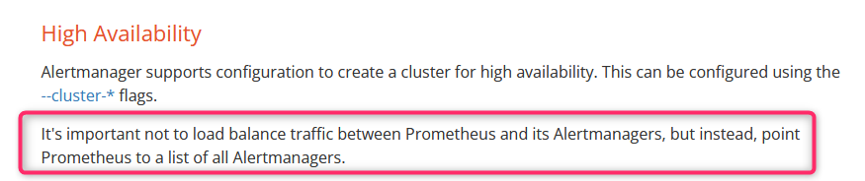

High-availability Alert Manager setup
Workernode1
Master node
Alertmanager1
Prometheus
Workernode2
Alertmanager2

Slide 86
10 NOW WE WILL TALK ABOUT
Lab for Alert Manager

Slide 87
11 NOW WE WILL TALK ABOUT
Prometheus High Availability

Slide 88
Prometheus HA
Why Prometheus HA
Multiple Prometheus servers
Lab for Multiple Prometheus servers
Prometheus Federation
Type of Federation Lab

Slide 89
Why Prometheus HA
High-availability systems are designed to keep working even if something fails.
High availability is not only important for customer facing software, but if the monitoring infrastructure itself
Prometheus also work in high availability like Alertmanager?

Slide 90
Why Prometheus HA & Multiple Prometheus
Prometheus 1
Targets
Alert Manager
Prometheus 2
global:
external_labels:
replica: A # B for the second replica.
alerting:
alert_relabel_configs:
# Drop the "replica" label.
- action: labeldrop
regex: replica

Slide 91
11 NOW WE WILL TALK ABOUT
Lab for Prometheus HA

Slide 92
Federation
Prometheus 1
Targets
Prometheus 2
https://prometheus.io/docs/prometheus/latest/federation/

Slide 93
Federation
Hierarchical federation
Cross-service federation

Slide 94
A higher-level Prometheus server (global Prometheus servers) which collect and store only aggregated time series data from those lower-level servers.
Higher-level Prometheus
This provides an aggregate global view and detailed local views.
These Prometheus server called as lower-level Prometheus server (local servers).
Prometheus 1
Prometheus 2
Prometheus 3
Prometheus 4
Prometheus 5
Each Prometheus servers collect data in high detail, such as using recording rules.
Datacenter3
Datacenter5
Datacenter1
Datacenter4
Example: We have 5 datacenters, and each datacenter has its own Prometheus server running.
Datacenter2
Hierarchical federation

Slide 95
Cross-service federation
One Prometheus server is configured to scrape one service or set of services from another Prometheus server to enable alerting and queries against both datasets within a single server.
Example:
One Prometheus server is configured to scrape the time series data of Infra part and another Prometheus server is configured to scrape the data of application only.
The application-monitoring Prometheus server scrapes CPU usage of Infra-monitoring Prometheus server. Which helps to run the queries for Infra CPU usage and application CPU usage.

Slide 96
Configuring federation
The Prometheus server also expose all data on /federate endpoint. Which allows us to retrieving the current value for a selected set of time series in that server.
Retrieving the specific time-series data, we can use match[] parameter.
We can use metrics name or labels on match [ ] syntax.

Slide 97
11 NOW WE WILL TALK ABOUT
Lab for Prometheus Federation

